Slide 1
VIRTUAL PRIVATE NETWORKS (VPN)
BY:
Diana Ashikyan
Nikhil Jerath
Connie Makalintal
Midori Murata

Slide 2
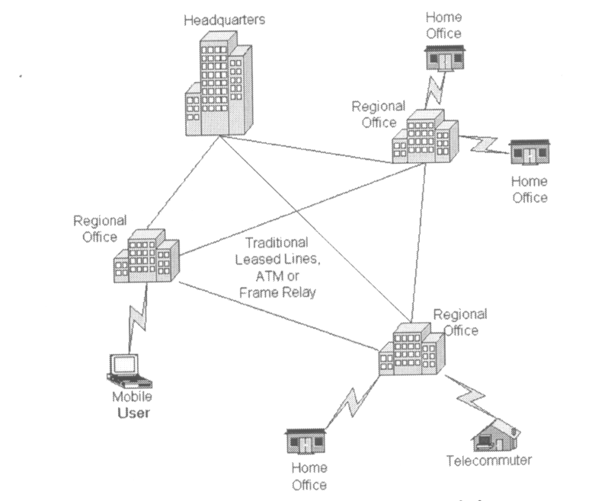
Traditional Connectivity
[From Gartner Consulting]

Slide 3
What is VPN?
Virtual Private Network is a type of private network that uses public telecommunication, such as the Internet, instead of leased lines to communicate.
Became popular as more employees worked in remote locations.
Terminologies to understand how VPNs work.

Slide 4
Private Networks vs.
Virtual Private Networks
Employees can access the network (Intranet) from remote locations.
Secured networks.
The Internet is used as the backbone for VPNs
Saves cost tremendously from reduction of equipment and maintenance costs.
Scalability

Slide 5
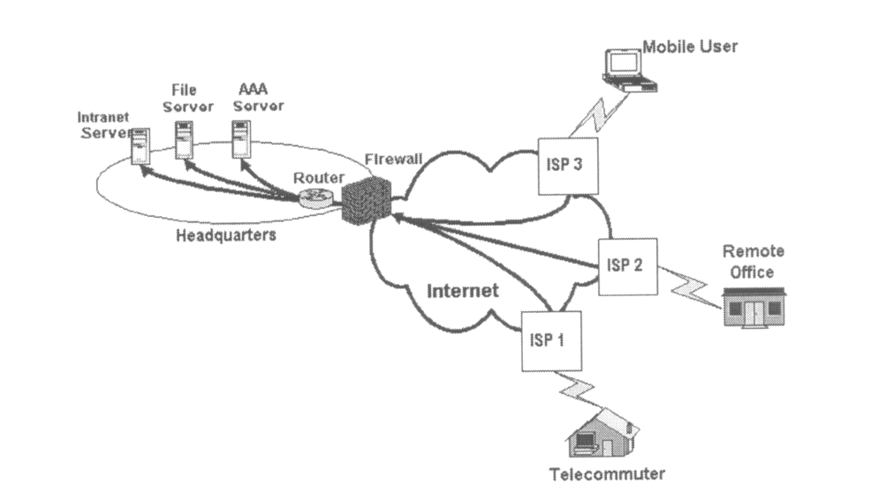
Remote Access Virtual Private Network
(From Gartner Consulting)

Slide 6
Brief Overview of How it Works
Two connections – one is made to the Internet and the second is made to the VPN.
Datagrams – contains data, destination and source information.
Firewalls – VPNs allow authorized users to pass through the firewalls.
Protocols – protocols create the VPN tunnels.

Slide 7
Four Critical Functions
Authentication – validates that the data was sent from the sender.
Access control – limiting unauthorized users from accessing the network.
Confidentiality – preventing the data to be read or copied as the data is being transported.
Data Integrity – ensuring that the data has not been altered

Slide 8
Encryption
Encryption -- is a method of “scrambling” data before transmitting it onto the Internet.
Public Key Encryption Technique
Digital signature – for authentication

Slide 9
Tunneling
A virtual point-to-point connection
made through a public network. It transports
encapsulated datagrams.
Original Datagram
Encrypted Inner Datagram
Datagram Header Outer Datagram Data Area
Data Encapsulation [From Comer]
Two types of end points:
Remote Access
Site-to-Site

Slide 10
Four Protocols used in VPN
PPTP -- Point-to-Point Tunneling Protocol
L2TP -- Layer 2 Tunneling Protocol
IPsec -- Internet Protocol Security
SOCKS – is not used as much as the ones above

Slide 11
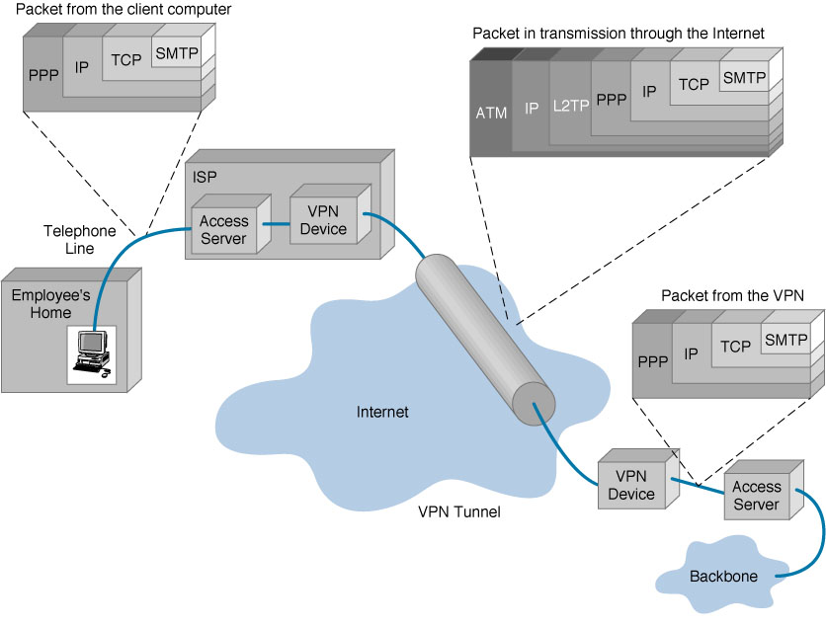
VPN Encapsulation of Packets

Slide 12
Types of Implementations
What does “implementation” mean in VPNs?
3 types
  Intranet – Within an organization
  Extranet – Outside an organization
  Remote Access – Employee to Business

Slide 13
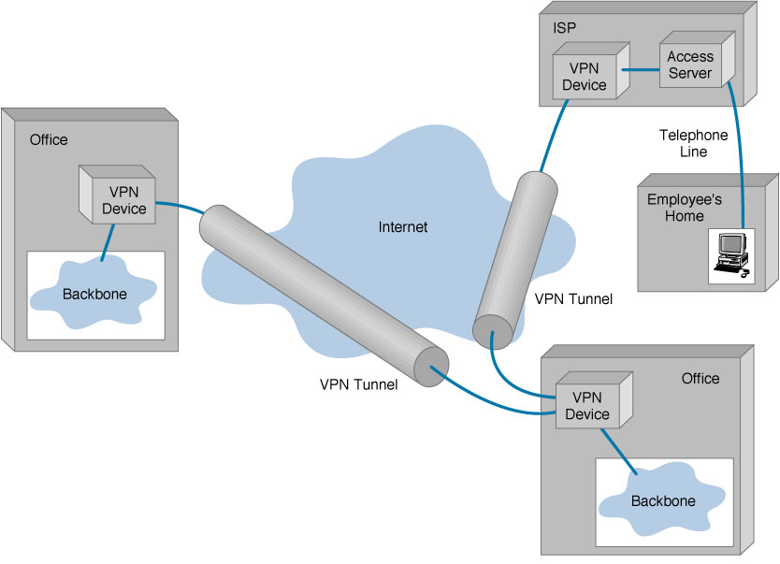
Virtual Private Networks (VPN)
Basic Architecture

Slide 14
Device Types
What it means
3 types
  Hardware
  Firewall
  Software

Slide 15
Device Types: Hardware
Usually a VPN type of router
Pros
Highest network throughput
Plug and Play
Dual-purpose
Cons
Cost
Lack of flexibility

Slide 16
Device Types: Firewall
More security?
Pros
“Harden” Operating System
Tri-purpose
Cost-effective
Cons
Still relatively costly

Slide 17
Device Types: Software
Ideal for 2 end points not in same org.
Great when different firewalls implemented
Pros
Flexible
Low relative cost
Cons
Lack of efficiency
More labor training required
Lower productivity; higher labor costs

Slide 18
Advantages
VS.
Disadvantages

Slide 19
Advantages: Cost Savings
Eliminating the need for expensive long-distance leased lines
Reducing the long-distance telephone charges for remote access.
Transferring the support burden to the service providers
Operational costs
Cisco VPN Savings Calculator

Slide 20
Advantages: Scalability
Flexibility of growth
Efficiency with broadband technology

Slide 21
Disadvantages
VPNs require an in-depth understanding of public network security issues and proper deployment of precautions
Availability and performance depends on factors largely outside of their control
Immature standards
VPNs need to accommodate protocols other than IP and existing internal network technology

Slide 22
Applications: Site-to-Site VPNs
Large-scale encryption between multiple fixed sites such as remote offices and central offices
Network traffic is sent over the branch office Internet connection
This saves the company hardware and management expenses

Slide 23
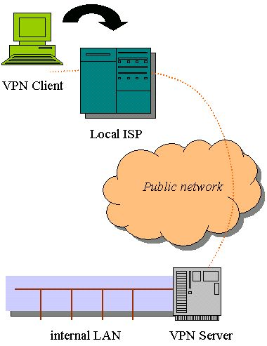
Site-to-Site VPNs

Slide 24
Applications: Remote Access
Encrypted connections between mobile or remote users and their corporate networks
Remote user can make a local call to an ISP, as opposed to a long distance call to the corporate remote access server.
Ideal for a telecommuter or mobile sales people.
VPN allows mobile workers & telecommuters to take advantage of broadband connectivity.
i.e. DSL, Cable

Slide 25
Industries That May Use a VPN
Healthcare: enables the transferring of confidential patient information within the medical facilities & health care provider
Manufacturing: allow suppliers to view inventory & allow clients to purchase online safely
Retail: able to securely transfer sales data or customer info between stores & the headquarters
Banking/Financial: enables account information to be transferred safely within departments & branches
General Business: communication between remote employees can be securely exchanged

Slide 26
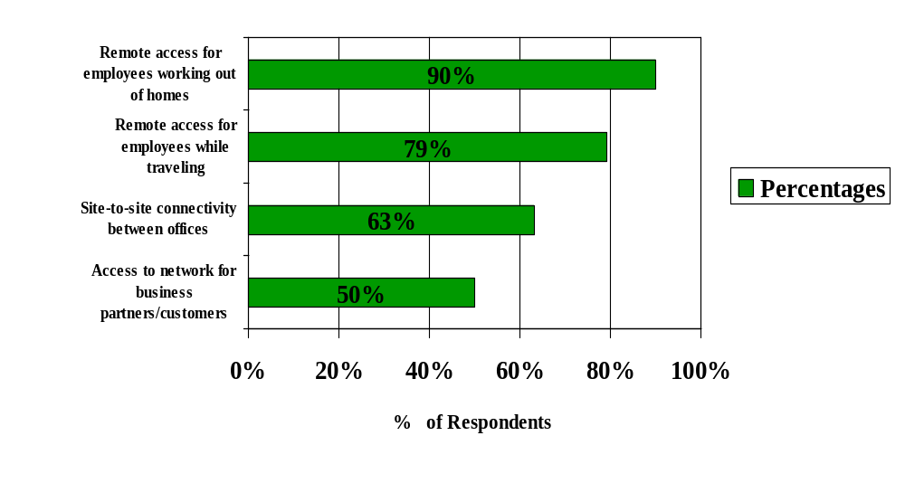
Statistics From Gartner-Consulting*
*Source: www.cisco.com

Slide 27
Some Businesses using a VPN
CVS Pharmaceutical Corporation upgraded their frame relay network to an IP VPN
ITW Foilmark secured remote location orders, running reports, & internet/intranet communications w/ a 168-bit encryption by switching to OpenReach VPN
Bacardi & Co. Implemented a 21-country, 44-location VPN

Slide 28
Where Do We See VPNs Going in the Future?
VPNs are continually being enhanced.
Example: Equant NV
As the VPN market becomes larger, more applications will be created along with more VPN providers and new VPN types.
Networks are expected to converge to create an integrated VPN
Improved protocols are expected, which will also improve VPNs.

Slide 29
Pop Quiz!
Q.1
VPN stands for…
a) Virtual Public Network
b) Virtual Private Network
c) Virtual Protocol Network
d) Virtual Perimeter Network

Slide 30
Pop Quiz!
A.1
VPN stands for…
b) Virtual Private Network
VPN stands for "Virtual Private Network" or "Virtual Private Networking." A VPN is a private network in the sense that it carries controlled information, protected by various security mechanisms, between known parties. VPNs are only "virtually" private, however, because this data actually travels over shared public networks instead of fully dedicated private connections.

Slide 31
Pop Quiz!
Q.2
What are the acronyms for the 3 most common VPN protocols?

Slide 32
Pop Quiz!
A.2
3 most common VPN protocols are…
PPTP
L2TP
IPsec
PPTP, IPsec, and L2TP are three of today's most popular VPN tunneling protocols. Each one of these is capable of supporting a secure VPN connection.

Slide 33
Pop Quiz!
Q.3
What does PPTP stand for?

Slide 34
Pop Quiz!
A.3
PPTP = Point-to-Point Tunneling Protocol !

Slide 35
Pop Quiz!
Q.4
What is the main benefit of VPNs compared to dedicated networks utilizing frame relay, leased lines, and traditional dial-up?
a) better network performance
b) less downtime on average
c) reduced cost
d) improved security

Slide 36
Pop Quiz!
A.4
The main benefit of VPNs is…
c) reduced cost
The main benefit of a VPN is the potential for significant cost savings compared to traditional leased lines or dial up networking. These savings come with a certain amount of risk, however, particularly when using the public Internet as the delivery mechanism for VPN data.

Slide 37
Pop Quiz!
Q.5
In VPNs, the term "tunneling" refers to
a) an optional feature that increases network performance if it is turned on
b) the encapsulation of packets inside packets of a different protocol to create and maintain the virtual circuit
c) the method a system administrator uses to detect hackers on the network
d) a marketing strategy that involves selling VPN products for very low prices in return for expensive service contracts

Slide 38
Pop Quiz!
A.5
In VPNs, the term "tunneling" refers to…
b) the encapsulation of packets inside packets of a different protocol to create and maintain the virtual circuit

